Slide 1
INTRODUCE AND REPORT PROJECT
STORM
- Website about online shopping-
Team 1: Daughters Of Storm

Slide 2
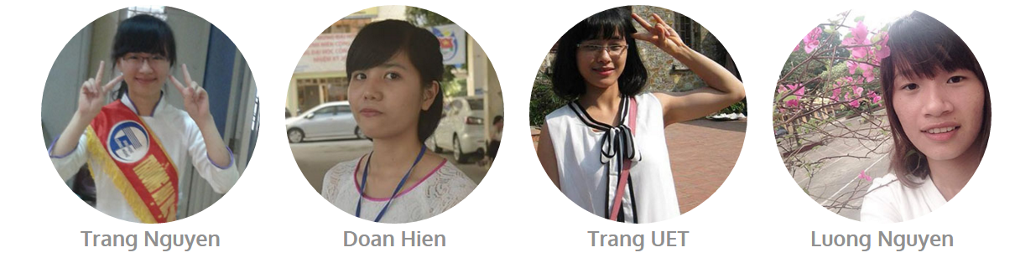
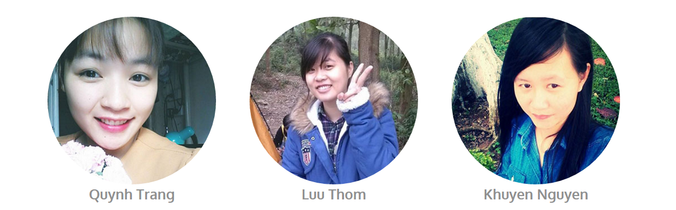
Member:

Slide 3




Slide 4
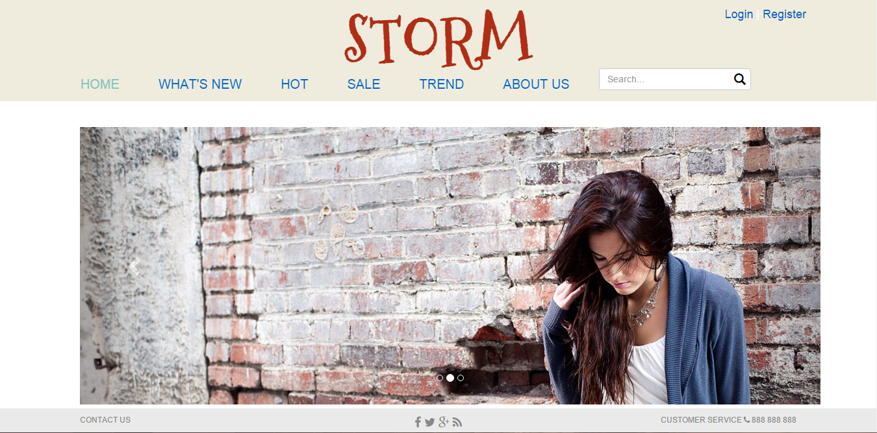
I. Introduction
Interface
Homepage

Slide 5
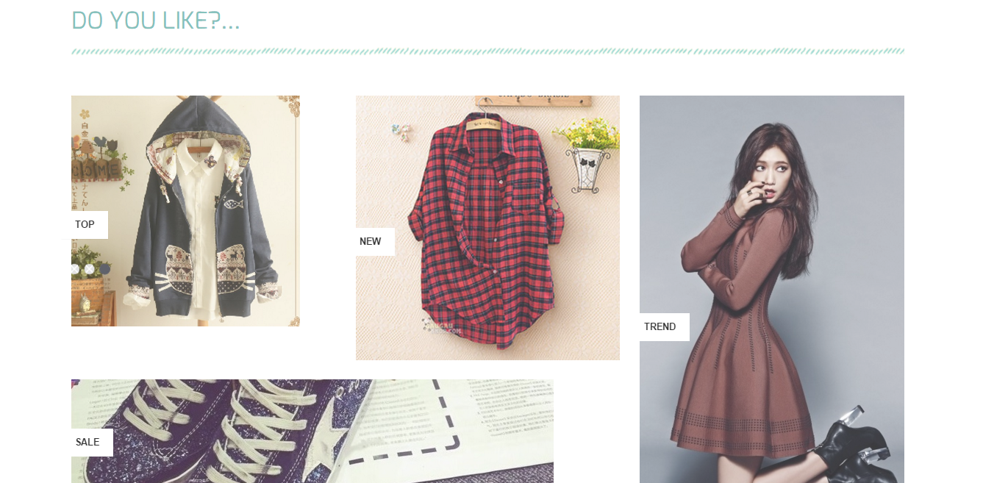
Homepage

Slide 6
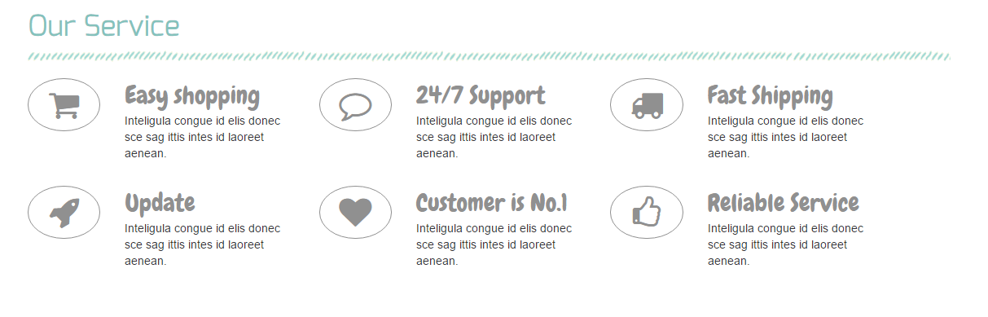
Homepage

Slide 7
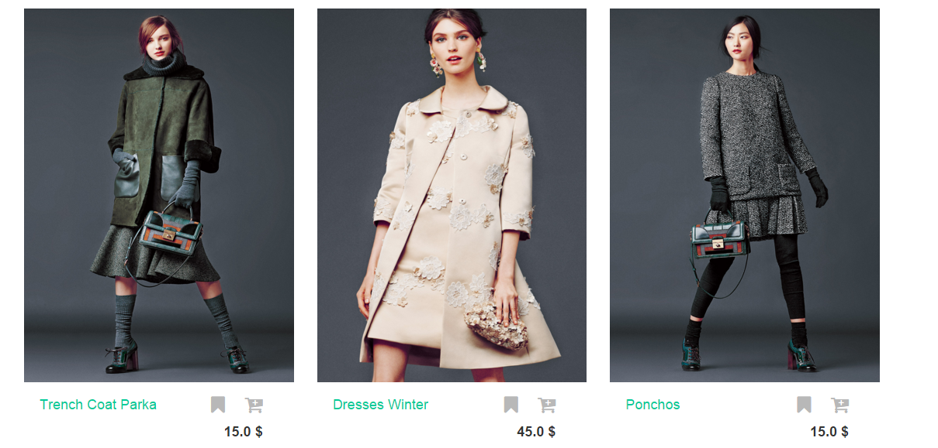
List products

Slide 8
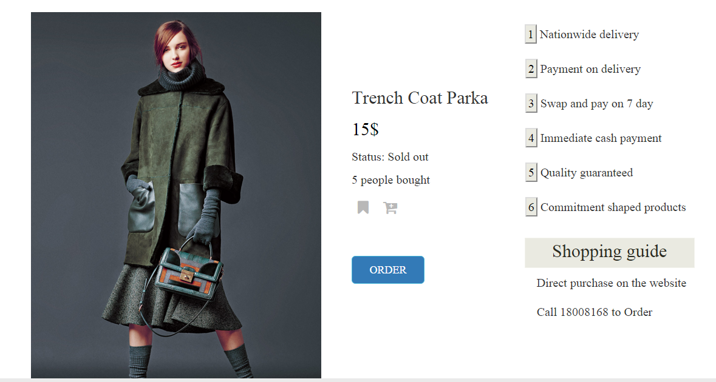
Detail product

Slide 9
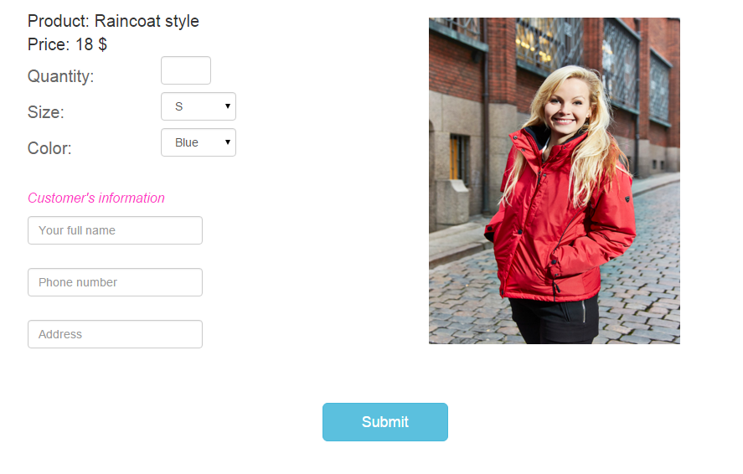
Order

Slide 10
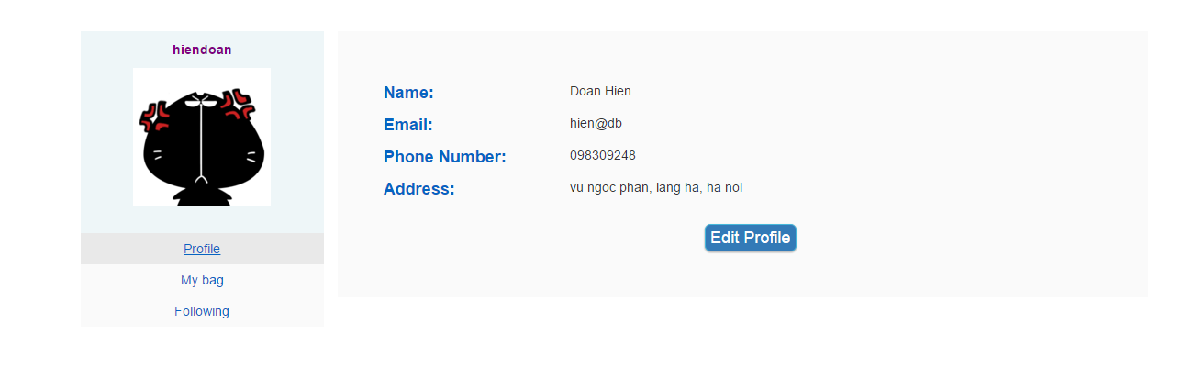
Personal

Slide 11
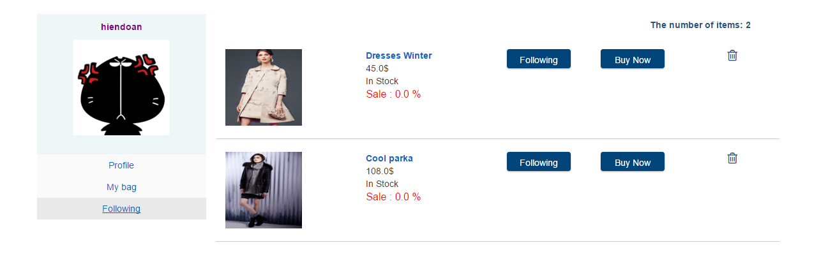
My bag and my following

Slide 12
2. Demo function
Register, login, logout
Add to cart
Follow product
Delete product from cart, following
Order a product
Review product
Edit personal information

Slide 13
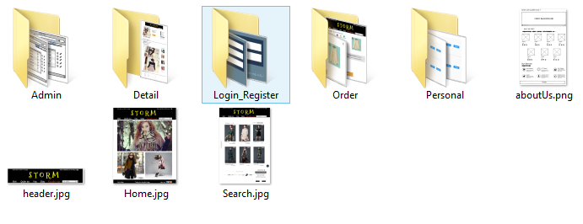
II. Report
1. Design
Design UI
Design Database
Detail in Database.pdf

Slide 14






2. Tool

Slide 15
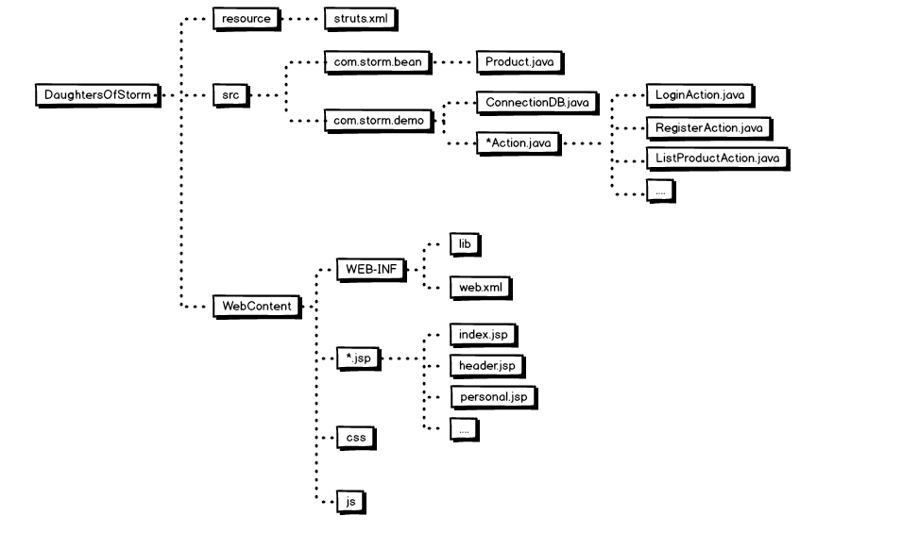
3. Code Strut2

Slide 16
4. Document
DesignUI, design database
Test case: 12 files
Usecase Diagram
Class Diagram
User guide
Installtion guide
Requirement Analysis Document (RAD)
Software Requirement Specification (SRS)

Slide 17
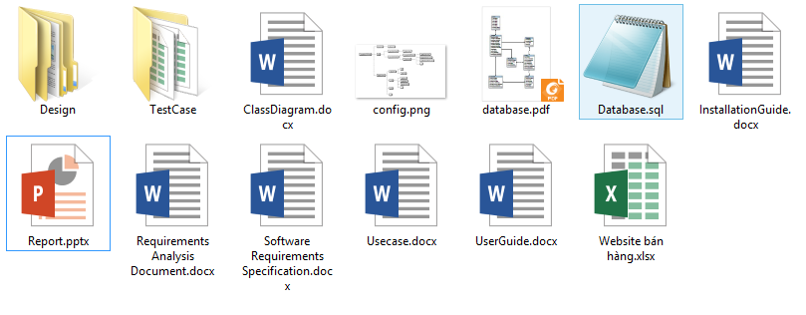
4. Document

Slide 18
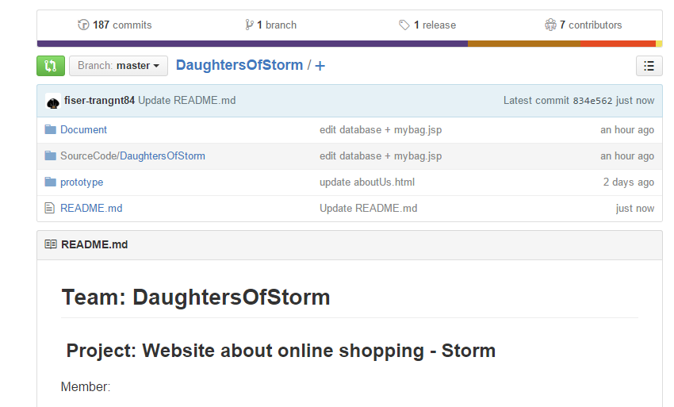
Github
187 commits

Slide 19
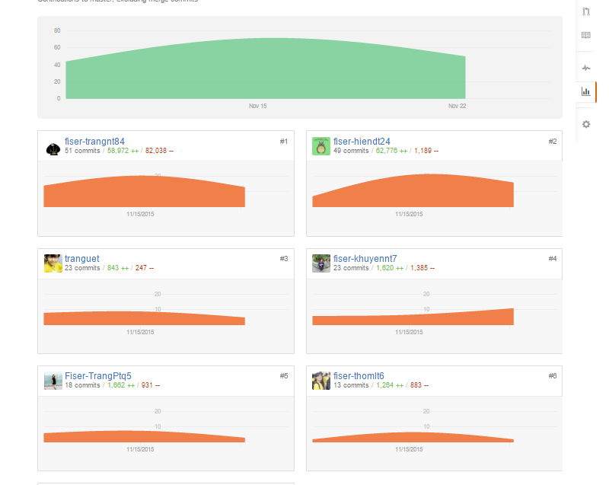
Github

Slide 20
Cảm ơn các bạn đã theo dõi!

